Slide 1
Introduction to Robotics
Both names and affiliations, or just individual? Up to you

Slide 2
Learning Objectives
Over the next x, you will work in teams to build and code a robot from scratch.
On y, your team will participate in a challenge to determine the winner!

Slide 3
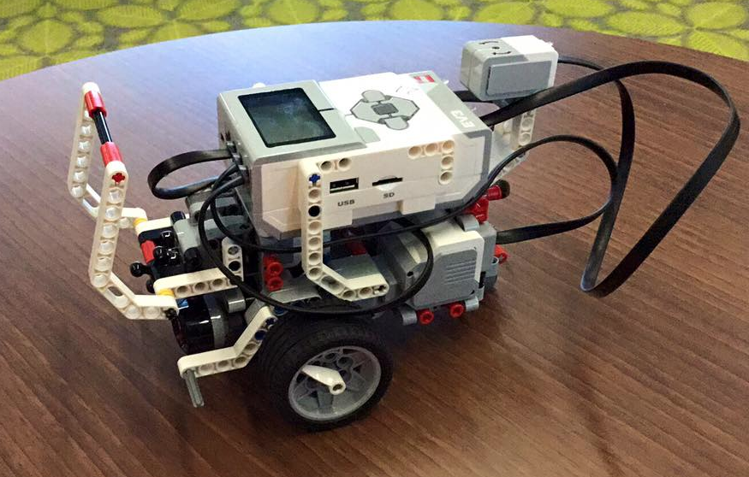
Meet your Robot

Slide 4
Meet your Robot
You are responsible for everything – from building to coding.
You will be working and competing in teams.
Split into teams.

Slide 5
Schedule
(Basic schedule of work here, showing supervised and unsupervised sessions.)
You are only allowed access to your robot at these times, so plan accordingly!
week | Tuesday (supervised) | Thursday (unsupervised)
1 | LEGO 1 | Study Skills
2 | LEGO 2 | ?
3 | LEGO 3 | Study Skills
4 | LEGO 4 | ?

Slide 6
Start Building!
On Moodle, you should find a list of instructions that will allow you to build your robot.
You should aim to build a base robot in this session by following the instructions in build_base robot.pdf

Slide 7
(MZ only?)
To build the base robot, you need to collect parts which you will keep for the next 4 weeks.
Please only take what you require.

